Slide 1


tracking bag
The ultimate solution for improving travelLers experience

Slide 2
Have you ever had a problem with your luggage?

Slide 3

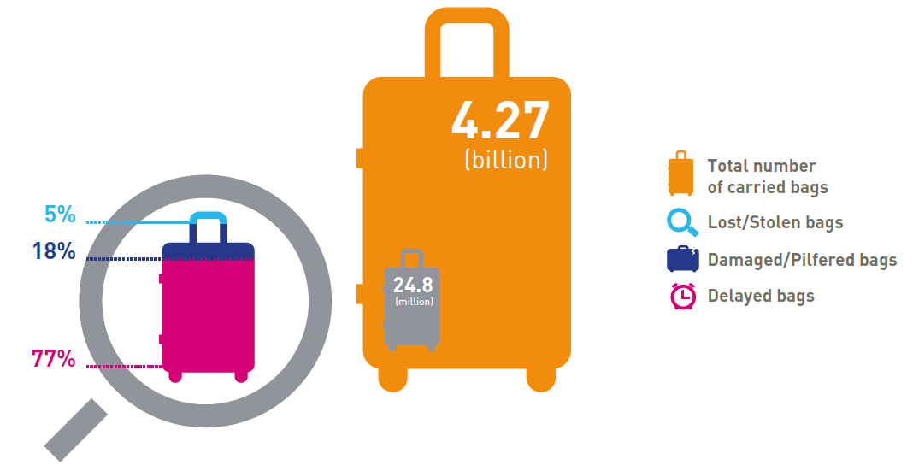
PROBLEM
24.8 million incidences in 2018
Costs $2.4 billion
1

Slide 4
Is there any solution yet?

Slide 5
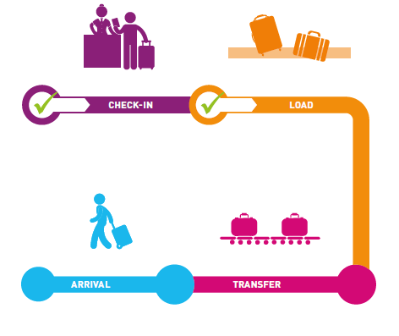
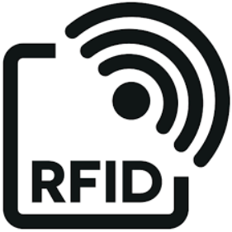
Tracking AT specific points
?
?
?
?

Slide 6
Our proposal

Slide 7

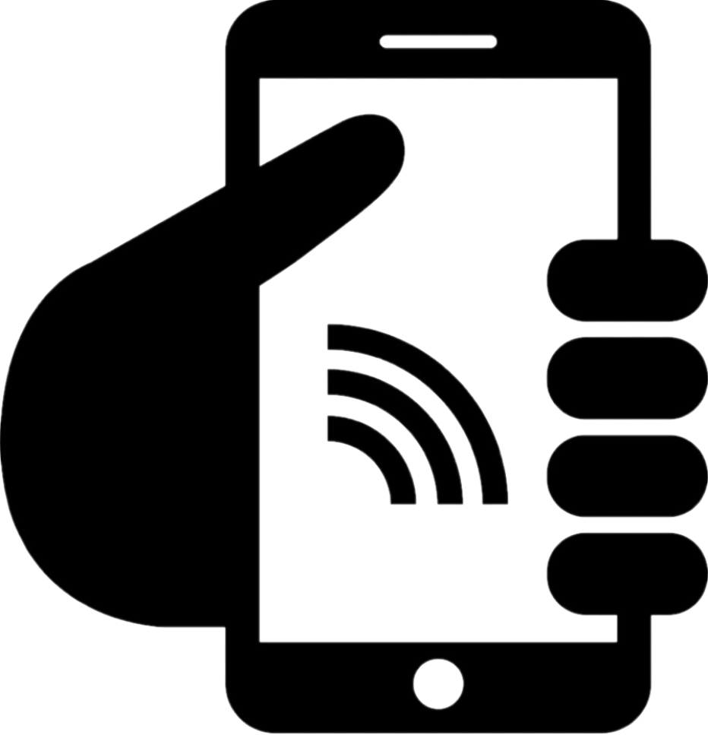
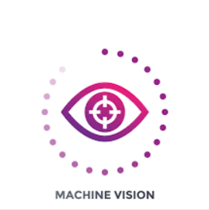
Tracking The whole flow
IMAGE RECOGNITION
Notes:
Currently, RFID is used in order to identify when the baggage passes through the 4 tracking points.
Our proposal is to combine RFID with image recognition. So, when a bag is missed, it is easier and quicker to find it back.
The information given by RFID and image recognition will be shared with the passengers by a convenient mobile app, increasing their satisfaction.

Slide 8
Demo

Slide 9



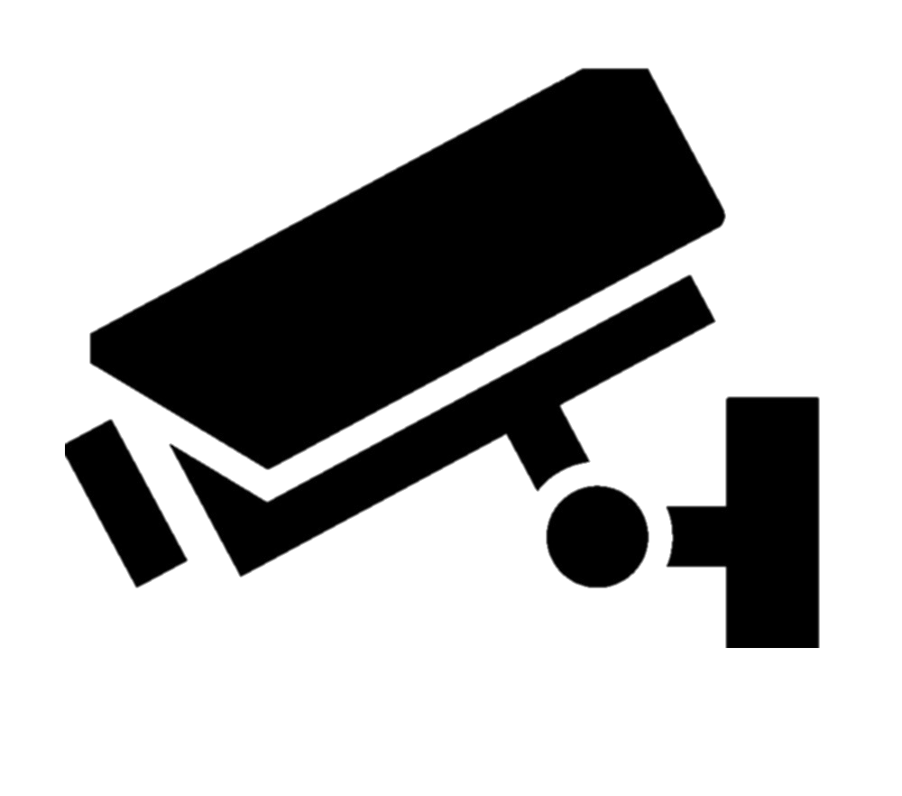
Infrastructure
API
SMS
Bash
URL https
Airport cameras
Python
OpenCV
Ask for periods of time
Notes:
Currently, RFID is used in order to identify when the baggage passes through the 4 tracking points.
Our proposal is to combine RFID with image recognition. So, when a bag is missed, it is easier and quicker to find it back.
The information given by RFID and image recognition will be shared with the passengers by a convenient mobile app, increasing their satisfaction.

Slide 10
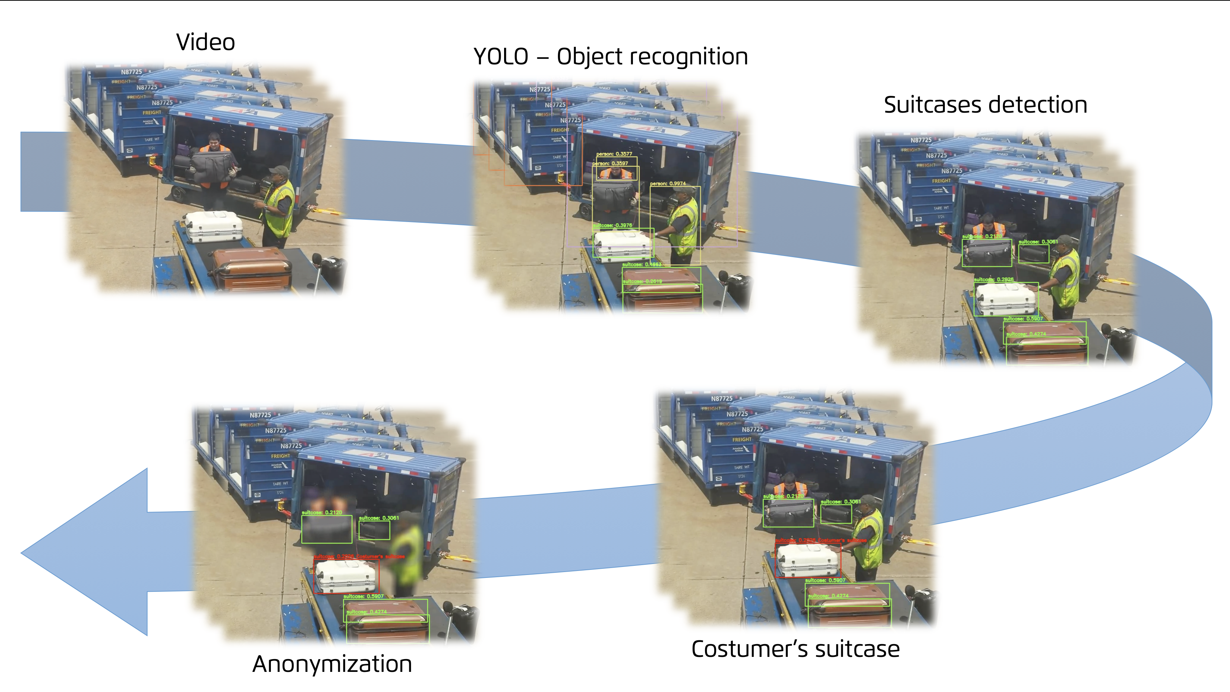
Infrastructure
Notes:
Currently, RFID is used in order to identify when the baggage passes through the 4 tracking points.
Our proposal is to combine RFID with image recognition. So, when a bag is missed, it is easier and quicker to find it back.
The information given by RFID and image recognition will be shared with the passengers by a convenient mobile app, increasing their satisfaction.

Slide 11
THANKS FOR YOUR ATTENTION

